Slide 1

PROPERTY DESCRIPTORS
Andrew Barbour

Slide 2
Property Descriptors
Allows for more precise, granular customization of object properties
Properties more than just key/value pairs
Each object property has a property descriptor with three property flags and a value or getter/setter
Property flags: configurable, writable, enumerable
Two types of property descriptors: data descriptors and access descriptors

Slide 3
Property Descriptor Attributes
enumerable – if property shows up during enumeration (via the spread operator, Object.assign, for…in, and Object.keys()
writable – property value can be reassigned
configurable
property flags can be changed
the property can be deleted
the property type can be changed between data and accessor descriptor
set and get methods define accessor descriptors. Intercepted and called any time the property is get or set through regular object methods

Slide 4
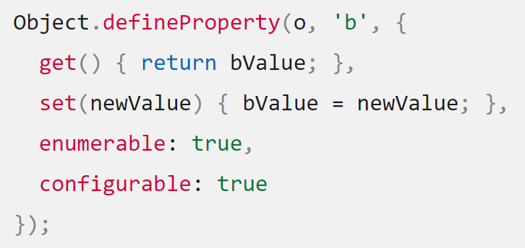
Defaults & Syntax
All object properties created without Object.defineProperty have default data descriptors with all flags set to true
Property flags created with defineProperty default to false

Slide 5
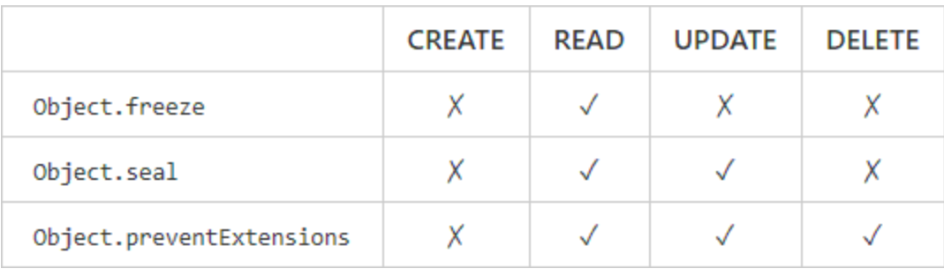
Global Methods
Globally set and query property descriptor flags for all properties
Each also has query methods (e.g., Object.isFrozen)

Slide 6
Use Cases
Allows more granular customization of object properties and permissions
Can change behavior and implement other functionality every time a developer user tries to get/set a property
Configure access and edit permissions for properties
Often used in library code to communicate API expectations, ensure immutability and idempotency for pure functions, and define custom behavior
Used frequently by in the React source code by maintainers

Slide 7
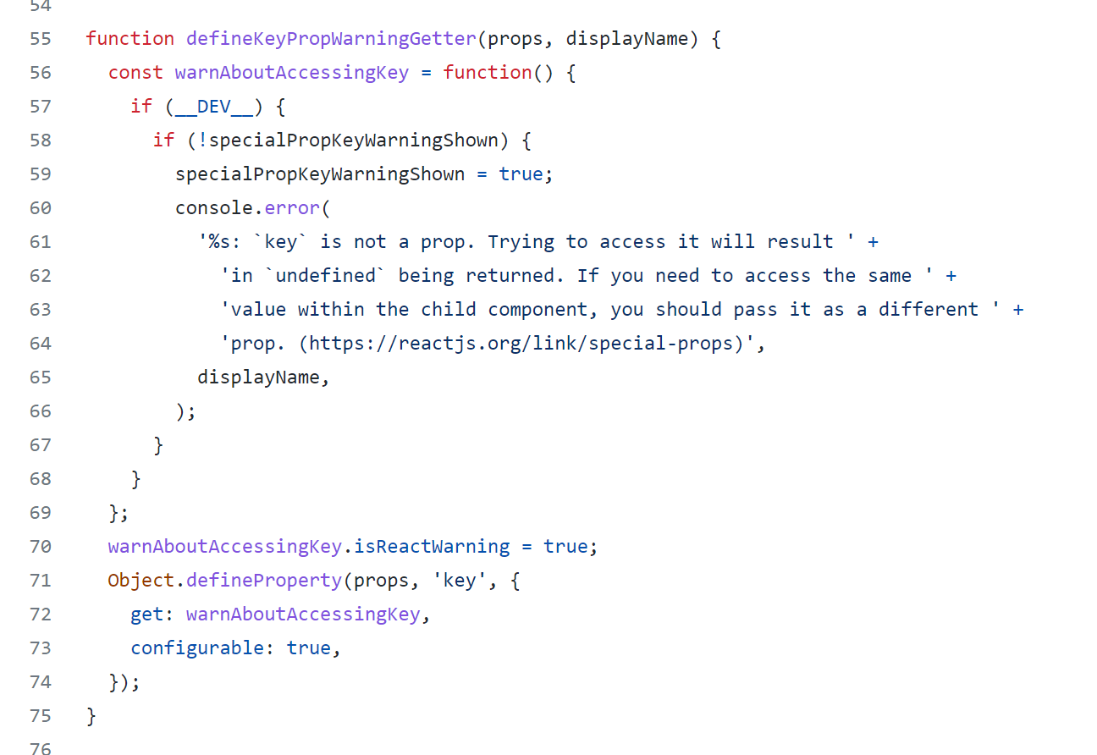
Case Study: React
https://github.com/facebook/react/blob/main/packages/react/src/ReactElement.js

Slide 8
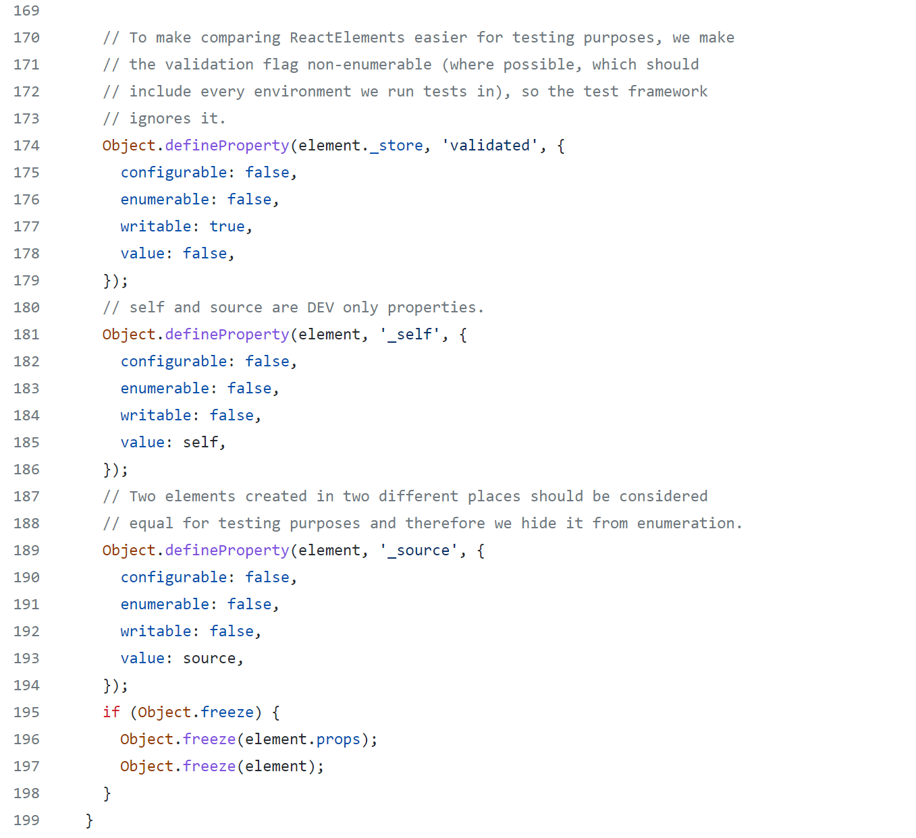
Case Study: React
https://github.com/facebook/react/blob/main/packages/react/src/ReactElement.js

Slide 9
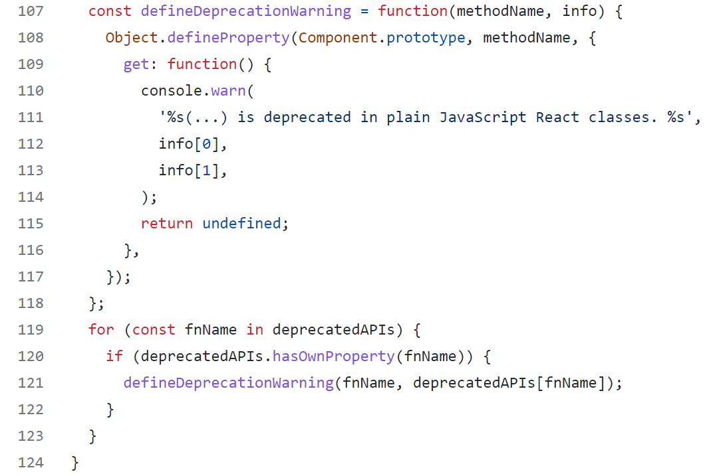
Case Study: React
https://github.com/facebook/react/blob/main/packages/react/src/ReactBaseClasses.js

Slide 10
References
Property Descriptors
https://developer.mozilla.org/en-US/docs/Web/JavaScript/Reference/Global_Objects/ Object/defineProperty
https://javascript.info/property-descriptors
React Source Code: Case Studies
https://github.com/facebook/react/blob/main/packages/react/src/ReactElement.js
https://github.com/facebook/react/blob/8e2bde6f2751aa6335f3cef488c05c3ea08e074a/packages/react/src/jsx/ReactJSXElement.js
https://github.com/facebook/react/blob/main/packages/react/src/ReactBaseClasses.js
https://github.com/facebook/react/blob/8e2bde6f2751aa6335f3cef488c05c3ea08e074a/packages/react-native-renderer/src/legacy-events/SyntheticEvent.js

